Slide 1
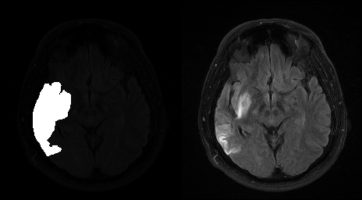
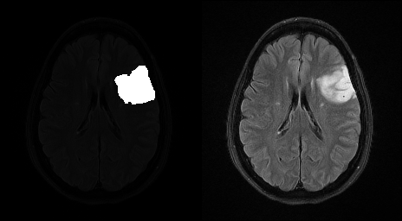
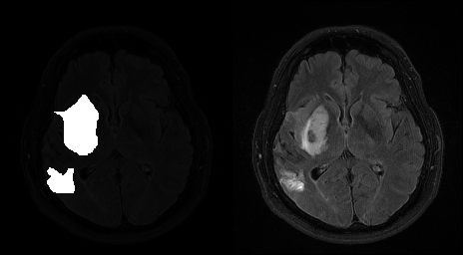
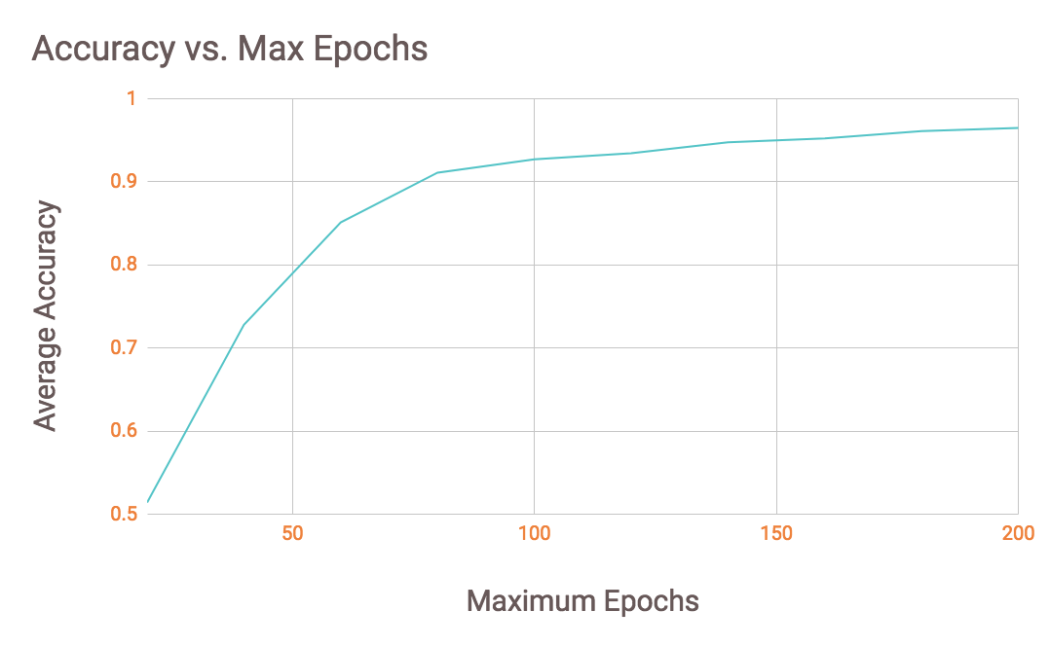
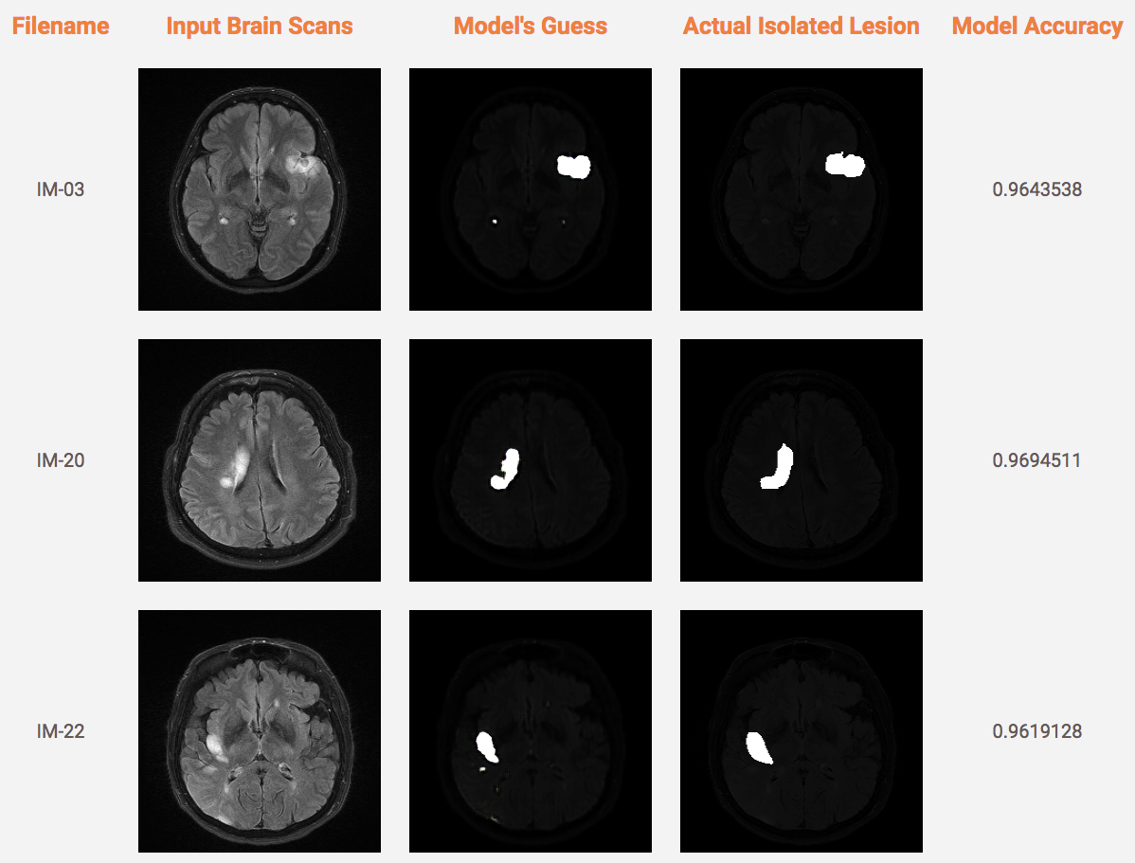
Brain Lesion Segmentation
Nathan Tsai 304575323
Bradley Zhu 304627529
University of California, Los Angeles
Background
Effective diagnosis of medical conditions, including brain tumors and strokes, requires accurately distinguishing between unhealthy brain tissues and tumors from healthy brain tissue
Image segmentation is crucial in analyzing medical images and is considered the first and critical step in many clinical applications, including accurate detection of brain lesions
Current techniques use FLAIR, DW, and CAT to image the brain for brain lesion detection and image segmentation implementation.
FLAIR (fluid attenuation inversion recovery) removes cerebrospinal fluid from images by implementing an inversion recovery sequence
DWI-MRI (diffusion weighted magnetic resonance imaging) measures the restricted diffusion of water within known tissues in order to produce neural tract images
CAT (Computerized Axial Tomography) scans utilize X-ray tests to produce cross- sectional images of bones, muscles, fats, and organs, including the brain
We will focus on analyzing the DWI-MRI technique by observing and studying abnormalities within the brain by observing areas appearing unusually brighter or darker than normal brain tissue
Methods
Obtained a combination of data from the BRATS (BRAin Tumor Segmentation) and other online brain tumor datasets (figshare)
Modified the TensorFlow pix2pix, an open source machine learning library in order to train, tune, build, and test our neural network with Python
Processed MRI brain scans to manually identify the location of brain lesions in order to train the neural network
Utilized image modifying software to highlight brain lesions
Potential source of error due to lack of professional brain lesion identification
Constructed scripts to
Prepare images for training
Split images into training and testing datasets
Train, tune, and test the model
Modify the max_epochs parameter of each model
Compute accuracy of each model
Display testing results into an HTML file
Training
Paired ground truth lesions with corresponding brain scans
Randomly split data set into training and testing directories
Trained on 35 brain scans, tested on 9
Relatively small dataset may be a potential source of error
Trained data set on 10 models by modifying the maximum number of epochs (iterations) from 20 to 200 in increments of 20
Compared the accuracy of each model by averaging the Structural Similarity Image Index (SSIM) of each model’s guess/truth pair
Results
Machine learning algorithm accurately identified brain lesions when the max_epochs parameter approached 200
However, there is an accuracy and performance trade-off
Training the model at 200 epochs took 8 hours on a personal laptop while only taking 20 minutes at 20 epochs
Figure 1: Training Data
Left half of each image is the ground truth (isolated brain lesion)
Right half of each image is the original MRI brain scan
Figure 3: Varying max_epochs parameter
Testing
Figure 3: Accuracy vs. Max Epochs
Increasing the max_epochs parameter increases the average accuracy of the model but also increases the training time
Conclusion
The neural network automates the tedious but crucial step of identifying abnormalities within the brain
With further training, tuning, and testing on a larger dataset, the neural network should be able to highlight brain lesions more quickly and accurately
A well-trained doctor utilizing a neural network with minimal error could increase the confidence of their diagnosis
This could save lives by detecting lesions when doctors miss them and prevent unnecessary surgeries when doctors misinterpret an MRI scan
References
Chen, Liang, et al. “Fully Automatic Acute Ischemic Lesion Segmentation in DWI using Convolutional Neural Networks.” ​ScienceDirect​, 13 June 2017,
https://www.sciencedirect.com/science/article/pii/S221315821730147X​. Accessed 6 May 2018.
Chilla, Geetha, et al. “Diffusion Weighted Magnetic Resonance Imaging and its Recent Trend.” US National Library of Medicine, 5 June 2015,
https://www.ncbi.nlm.nih.gov/pmc/articles/PMC4426106/. Accessed 3 May 2018.
“Computed Tomography (CT or CAT) Scan of the Brain.” Johns Hopkins Medicine, 4 April 2018,
https://www.hopkinsmedicine.org/healthlibrary/test_procedures/neurological/computed_tomography_ct_or_cat_scan_of_the_brain_92,p07650. Accessed 6 May 2018.
Lao, Zhiqiang, et al. “Computer-Assisted Segmentation of White Matter Lesions.” Advances in Pediatrics., U.S. National Library of Medicine, Mar. 2008,
www.ncbi.nlm.nih.gov/pmc/articles/PMC2528894/. Accessed 3 May 2018.
Noh, Hyeonwoo, et al. “Learning Deconvolution Network for Semantic Segmentation.” IEEE, 18 February 2016, https://ieeexplore.ieee.org/document/7410535/. Accessed 6
May 2018.
Figure 2: Testing Data
Trained model outputs a guess for each unseen brain scan
Model accuracy computed between guess and actual lesion against the SSIM index

